Slide 1
Accessing Taxonomic Data
Paul Oldham

Slide 2
You Cant Monitor Something you Don’t Know about
The availability of taxonomic information about a country is one of the single most important data sources for ABS monitoring.
If a country lacks information on species within a country it is not realistic to imagine a country will be able to monitor access and benefit-sharing with much success.
Using Taxonomic Data is about more than monitoring compliance with access and benefit sharing rules. It provides a window into the role of biodiversity in science & innovation.

Slide 3
Taxonomic Data
Taxonomic names are in reality quite tricky to work with because:
They change over time (as taxonomists reallocate species)
Spelling and punctuation may vary (a lot)
The rise of molecular taxonomy is leading to significant revisions and advances using short segments of DNA as signatures, known as DNA barcoding (Barcode of Life)
Environmental samples (metagenomics) from soil and water are leading to a growing number of cases where the species is not actually known, except in the broadest terms known but useful properties may be identified.

Slide 4
Sources of Taxonomic Information
One challenge with taxonomic data is that it may be stored in multiple locations in different forms (in spreadsheets, pdf or word documents and so on). This was part of the challenge we faced here in India and it is the same everywhere else.
I want to highlight three important developments
The Catalogue of Life as the main authority for valid taxonomic names
The Global Names Initiative as the main sources for extremely messy names as used by humans and tools for identifying and cleaning them up;
The Global Biodiversity Information Facility (GBIF)
In this session we will get to grips with some of these resources focusing on GBIF.

Slide 5
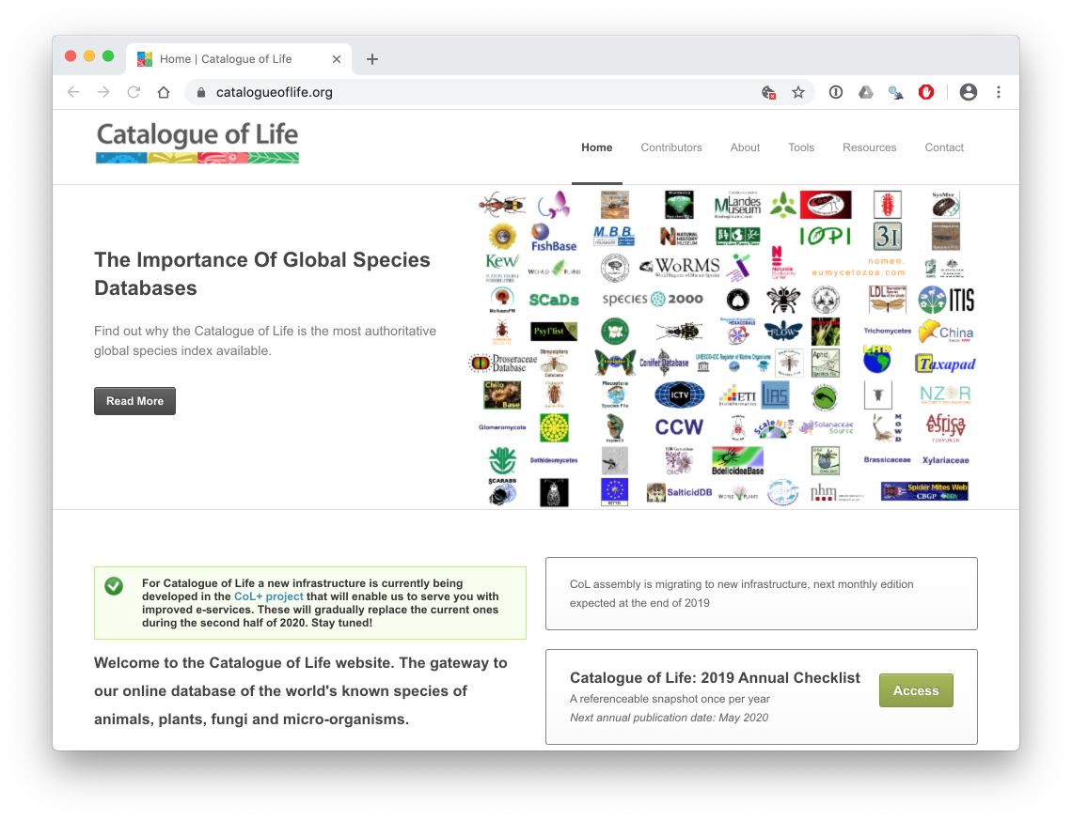

Slide 6
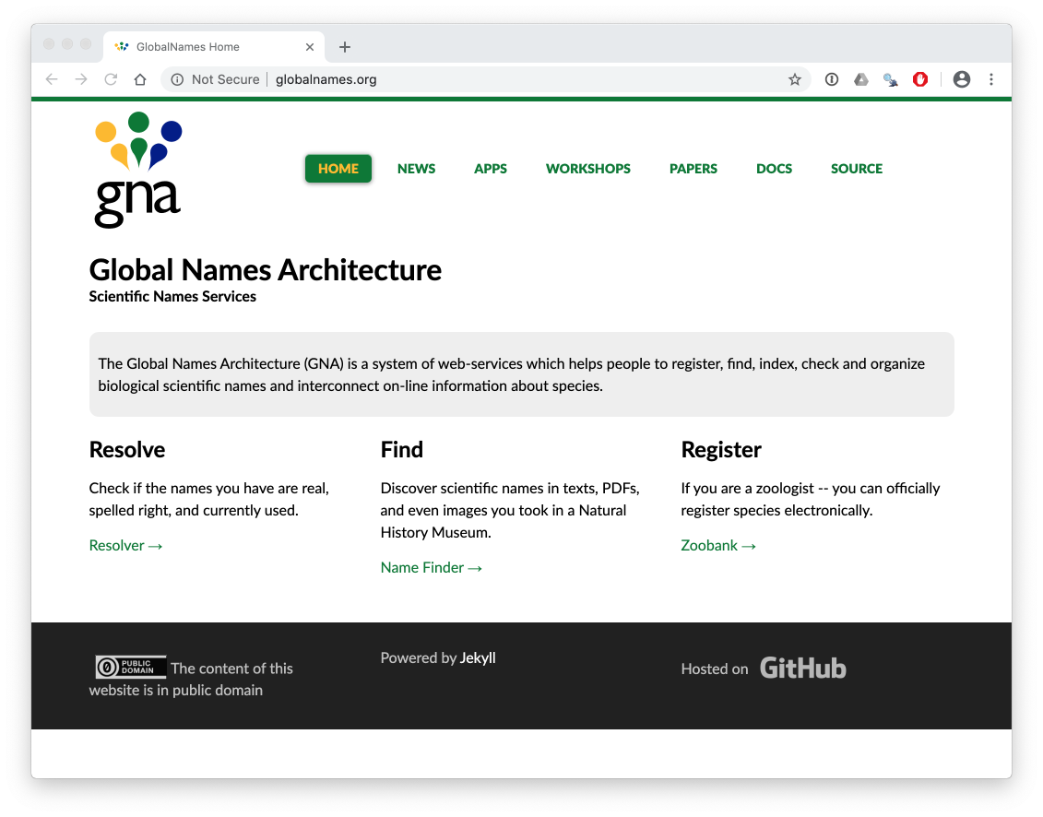

Slide 7
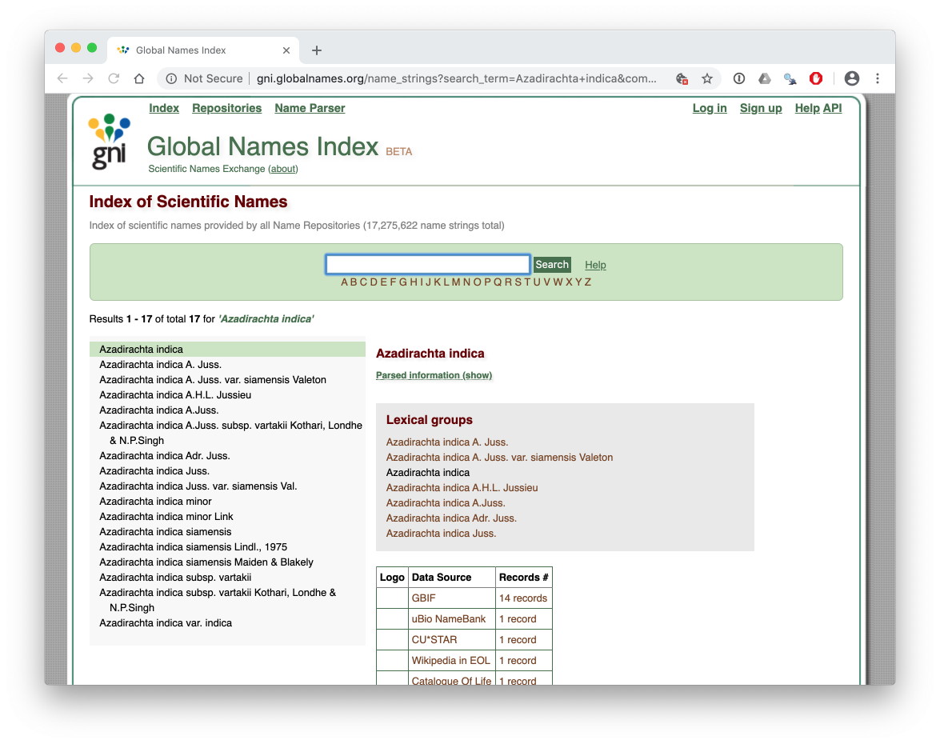

Slide 8
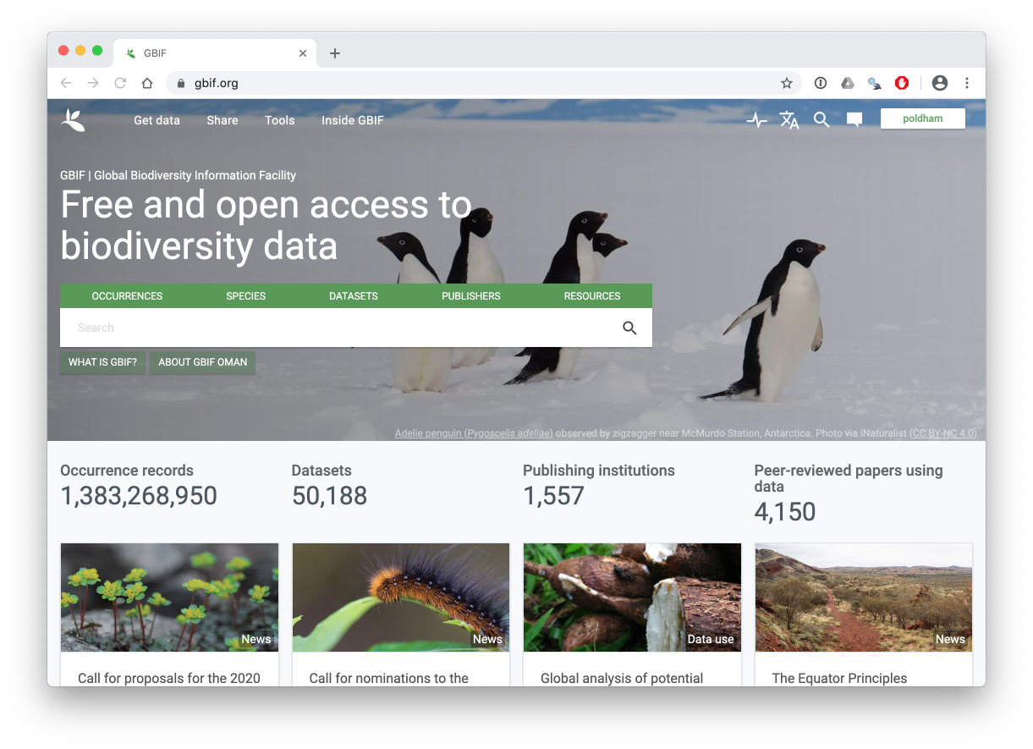

Slide 9
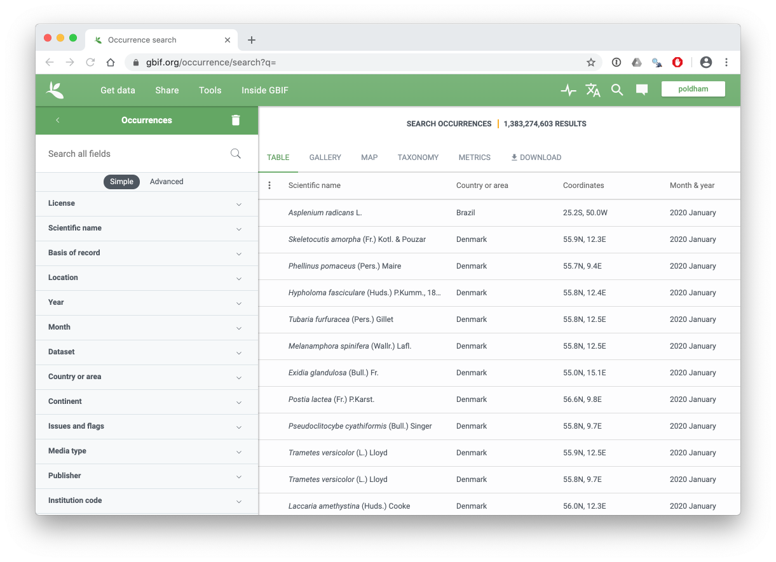

Slide 10
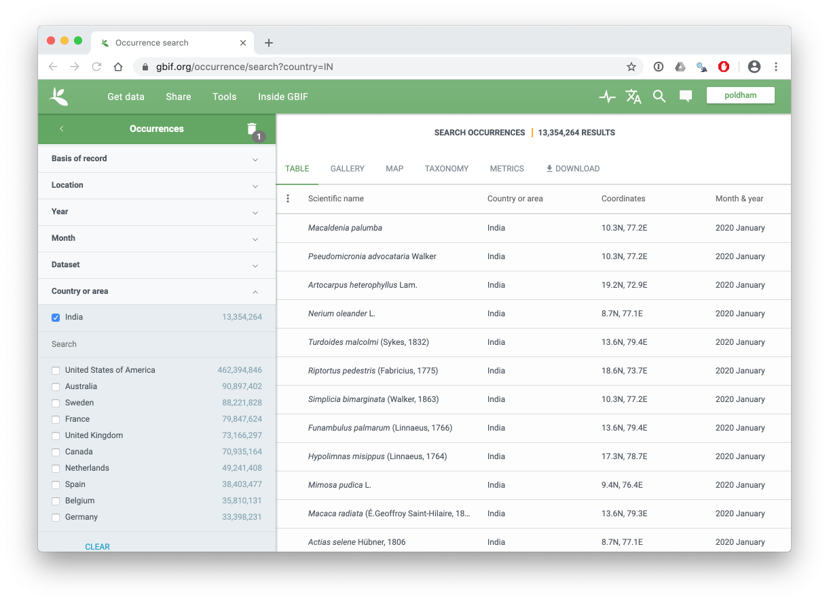

Slide 11
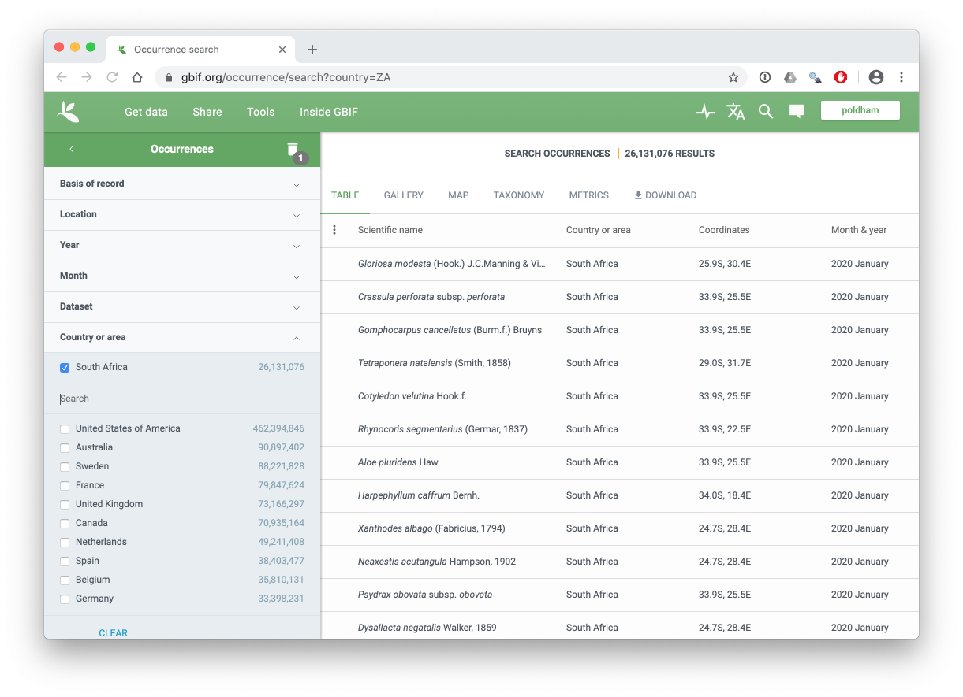
South Africa

Slide 12
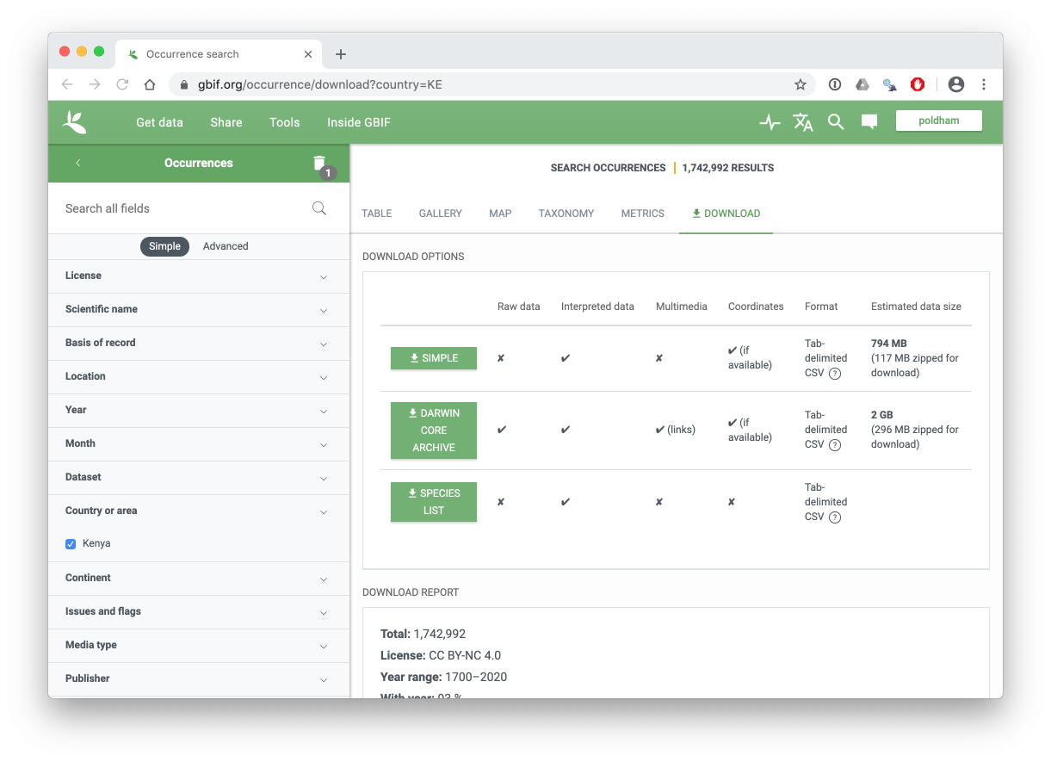

Slide 13
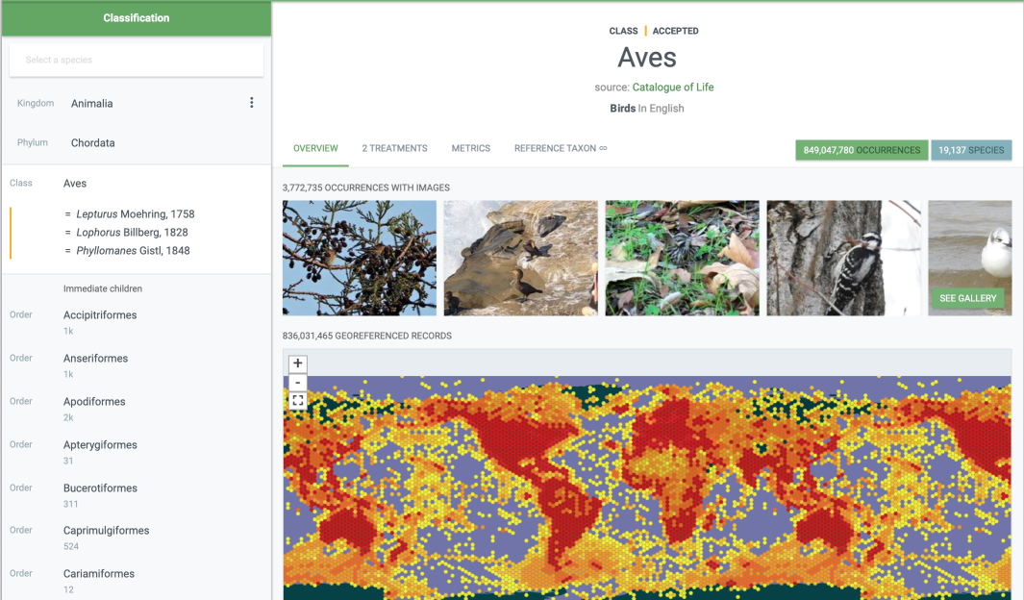
GBIF Occurrence records are dominated by birds (class Aves)

Slide 14
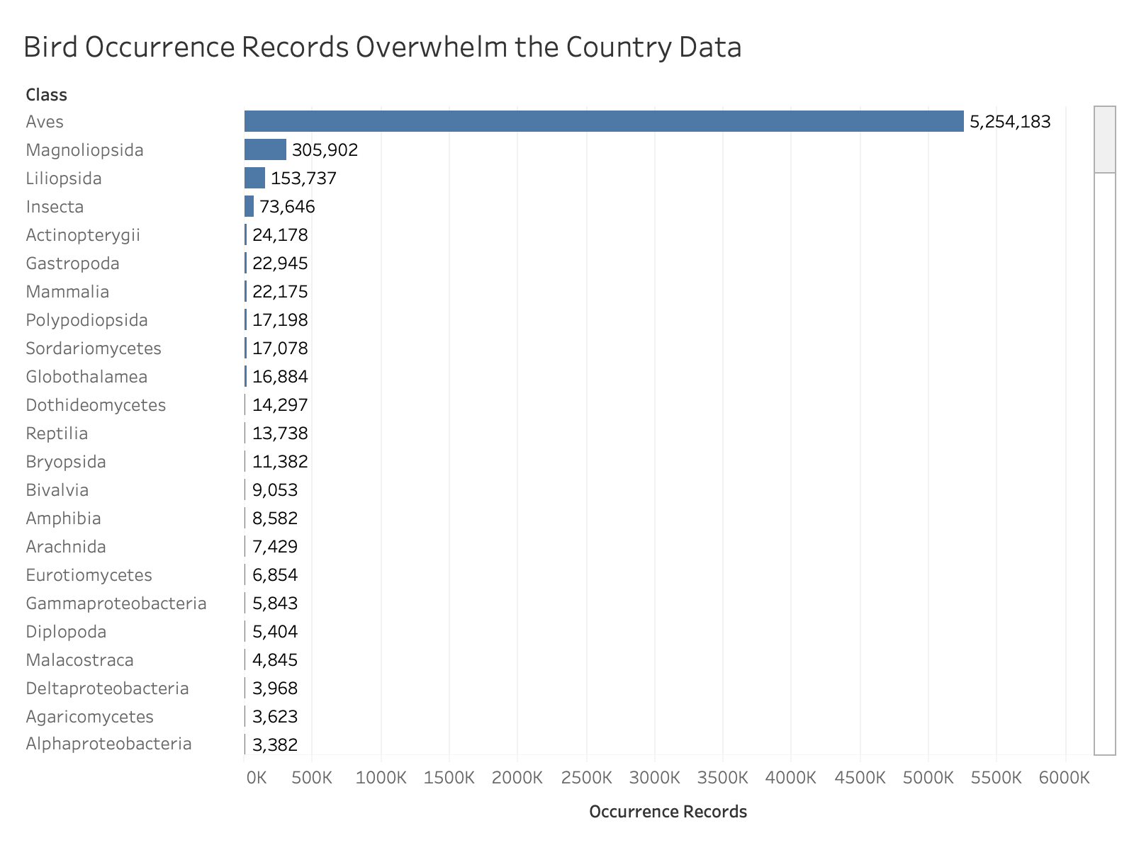
Bird Occurrence Records (India 2018 data)

Slide 15
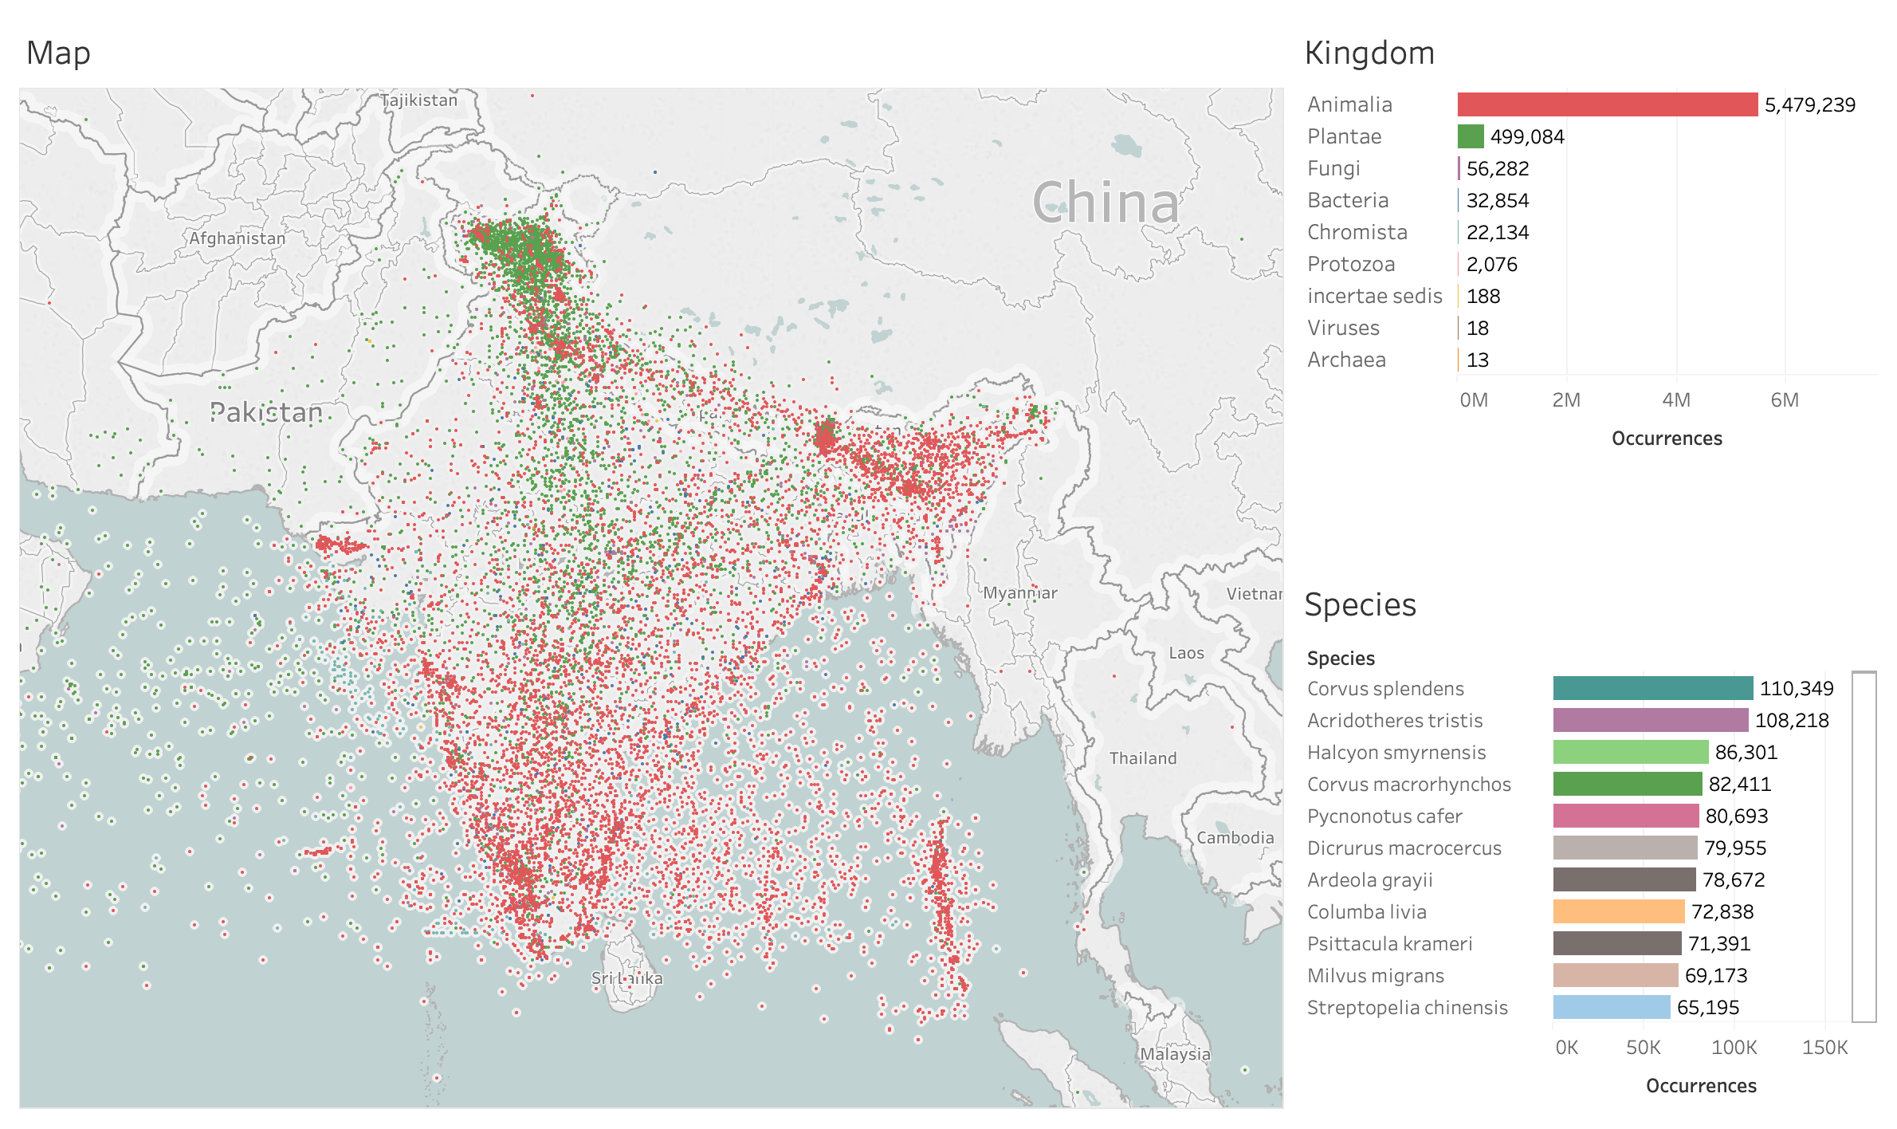

Slide 16
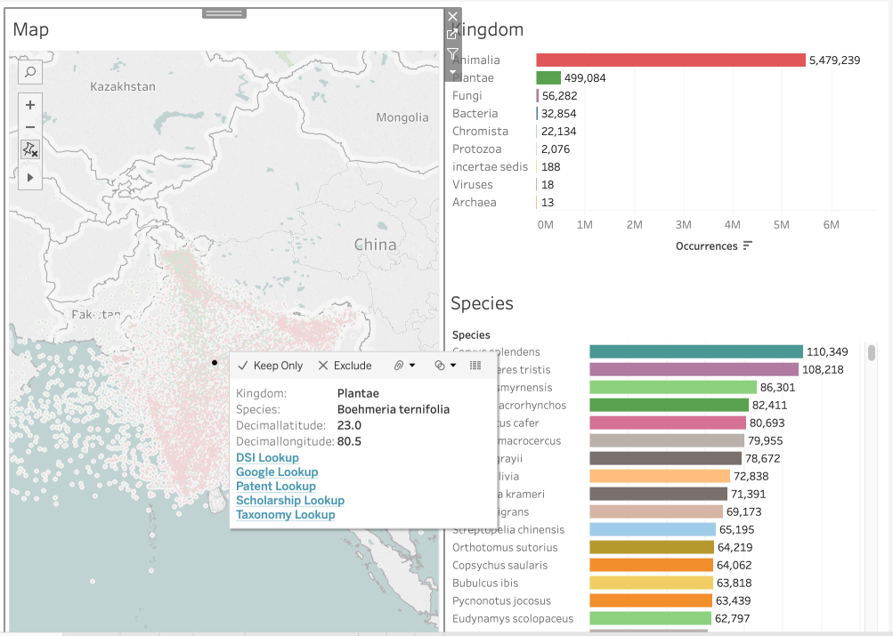

Slide 17
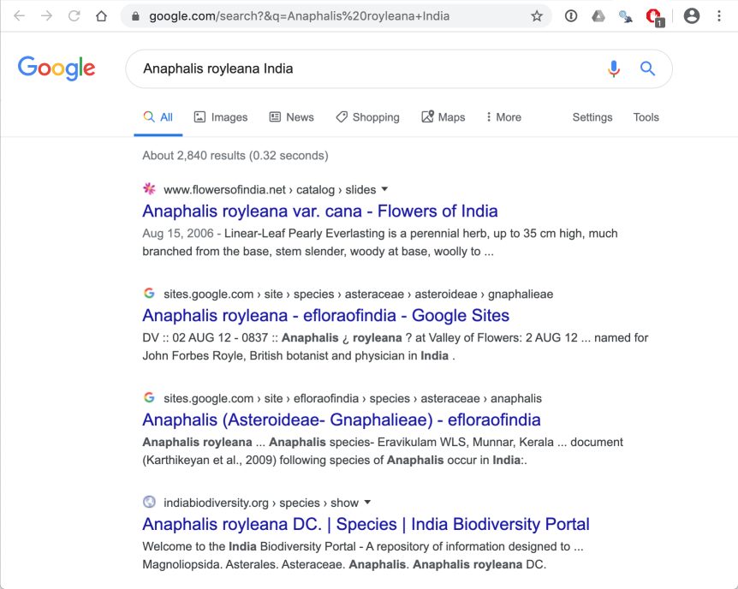

Slide 18
Your Turn!

